Slide 1
Fake News Detection
USING MACHINE LEARNING
Done By
Jesika G (team 4)

Slide 2
Introduction:
What is Fake News?
False or misleading information presented as news, often intended to mislead readers or achieve a specific agenda.
Goal of Fake News Detection:
Automatically classify news as fake or real using advanced algorithms.

Slide 3
Project Overview:
Objective: Classify news articles as fake or real using machine learning.
Approach: Analyze textual content, metadata, and source information.

Slide 4
Technology Stack:
Languages: Python
Libraries/Frameworks:scikit-learn,Pandas,NumPy
Deployment Tools: Flask/Django,AWS/GCP/Azure
Special Techniques: Grid search, RESTful API integration.

Slide 5
Pipeline:
Data Preprocessing
Feature Extraction
Model Training and Tuning
Evaluation

Slide 6
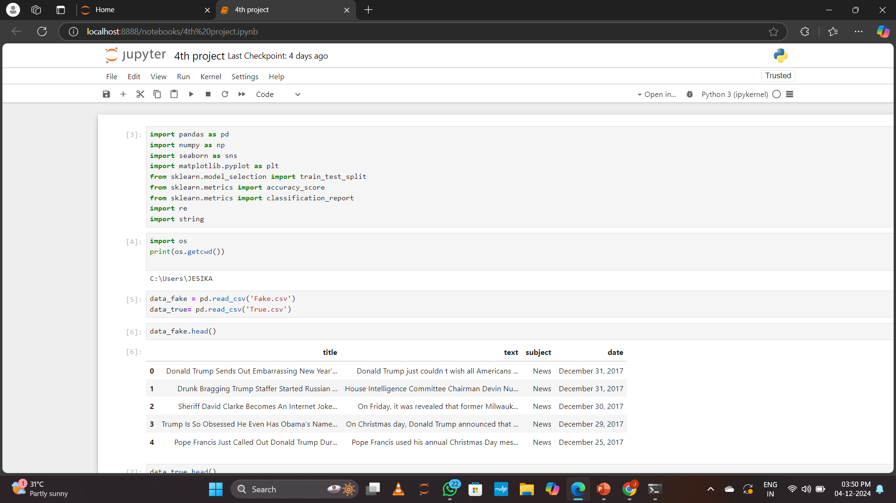
Code screensort:

Slide 7
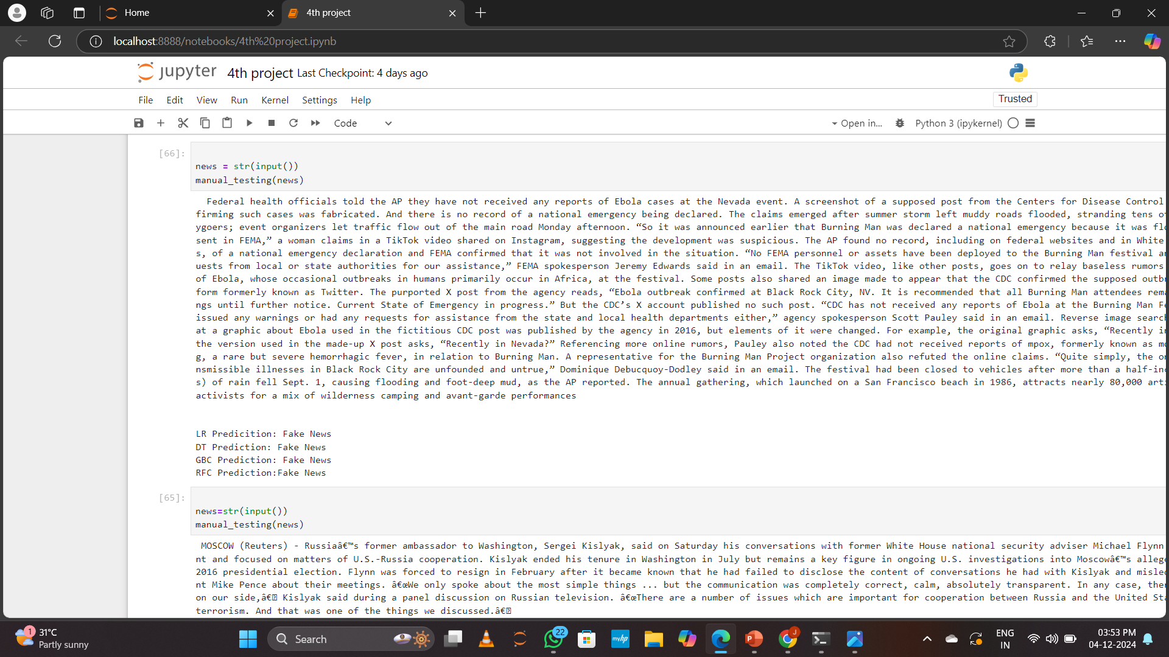
Output screensort:

Slide 8
Conclusion:
The Fake News Detection project aimed to develop a machine learning model that can accurately classify news articles as real or fake.
The project began with data collection, Various preprocessing steps were performed to clean the data.
Overall, the project successfully demonstrated that machine learning could play a critical role in combating fake news,

